Slide 1
AlKarkh University of Science College of science First year level
General chemistry Labs
Supervisor: Dr. Mohammed Abdul Baset Assistant: Anssam Dhaher Huessin
Lab -8-
CONDUCTOMETRIC TITRATION OF STRONG ACID WITH STRONG BASE
1. Introduction:
Solution of electrolytes conducts electricity due to the presence of ions. The specific conductance of a solution is proportional to the concentration of ions in it. The reaction between HCl and NaOH may be represented as,
HCl(aq) + NaOH(aq) → NaCl(aq) + H2O(l)
When a solution of hydrochloric acid (HCl) is titrated with NaOH, the fast moving hydrogen ions (k° H+ = 350 ohm⁻¹ cm⁻¹) are progressively replaced by slow moving sodium ions (X° Na+ = 50 ohm⁻¹ cm⁻¹). As a result conductance of the solution decreases, this decrease in conductance will take place until the end point is reached. Further addition of alkali raises the conductance sharply, as there is an excess of hydroxide ions (λ° OH– = 198 ohm–1 cm–1).
A graph is drawn between volume of NaOH added and the conductance of solution. The exact end point is intersection of the two lines.
Advantages of titration
There are several reasons why titration is used in laboratories worldwide:
1. Titration is an established analytical technique
2. It is fast
3. It is a very accurate and precise technique
4. A high degree of automation can be implemented
5. Titration offers a good price/performance ratio compared to more sophisticated techniques
6. It can be used by low-skilled and low-trained operators
7. No need for highly specialized chemical knowledge
Advantages of conductometric titrations are:
1. Conductometric titration can be used with very diluted solutions
2. Conductometric titration can be used with colored or turbid solutions in which end point cannot be seen by eye
3. Conductometric titration can be used where there is no suitable indicator
2. Objective: To determine the strength of a strong acid by titrating a strong acid and strong base conductometrically.
24

Slide 2
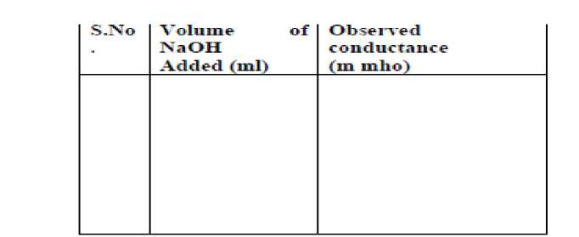
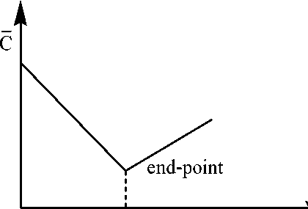
3. Apparatus and Chemicals: Conductometer, conductivity cell, beaker, pipette, burette, conical flask, Hydrochloric acid (HCl), sodium hydroxide (NaOH), conductivity water.
4. Procedure:
1. Carefully add the NaOH to the buret. You will need to drain some of the NaOH from the buret to fill the tip. Fill the buret so that the meniscus of the NaOH is sitting on the 0.00 mL mark with the tip filled.
2. Calibration of the instrument done at room temperature.
3. Rinse the conductivity cell a number of times with conductivity water or double distilled water.
4. Pipette out 10 mL of HCl in a beaker and dip the conductivity cell in it, so that the cell should dip completely in solution.
5. Note the temperature of the sample solution and accordingly set the temperature control or keep the cell in a thermostat at room temperature.
6. Add small amount of NaOH solution (1 ml) from burette, stir it and measure the conductance after each addition.
7. Take at least five readings beyond the end point.
8. Before you start the last trial, make sure that you have enough NaOH in the buret to complete the titration (use your values from the first and second trials to estimate the amount needed for the third trial).
9. Clean out the Erlenmeyer and dispose of any remaining acid or base by mixing together to neutralization, turn on the water, and drain into the sink.
5. Calculation:
Table:- Conductometric Titration
Volume of added NaOH
Volume of NaOH
25

Slide 3
7. Discussions:
i) Why you do not use indicator in conductometric titrations?
ii) Conductometric titration can be used with much diluted solutions. Why?
iii) Near the end point, no special case is necessary as it is determined graphically.
26

